Slide 1
Unit 2: Prerequisite

Slide 2
Content
Array
Structure

Slide 3
Array
• Array is a group of same type of variables that have common name
• Each item in the group is called an element of the array
• Each element is distinguished from another by an index
• All elements are stored contiguously in memory
• The elements of the array can be of any valid type- integers, characters, floating point types or user-defined types

Slide 4
Types of Array:
One dimensional array
Two dimensional array

Slide 5
One dimensional array:
The elements of the array can be represented either as a single column or as a single row
Declaring one-dimensional array:
data_type array_name[size];
Following are some valid array declarations:
int age[15];
float weight[50];
int marks[100];

Slide 6
Following are some invalid array declarations in c:
int value[0];
int marks[0.5];
int number[-5];

Slide 7
Array Initialization (1-D):
The general format of array initialization is:
data_type array_name[size]={element1,element2,…………..,element n};
for example:
int age[5]={22,33,43,24,55};
int weight[]={55,6,77,5,45,88,96,11,44,32};
float a[]={2,3.5,7.9,-5.9,-8};
char section[4]={‘A’,’B’,’C’,’D’};
char name[10]=”HARIBAHADUR”;

Slide 8
Two-Dimensional array:
When we declare two dimensional array, the first subscript written is for the number of rows and the second one is for the column.
Declaration of 2- D array:
data_type array_name[row_size][column_size];
Example;
int a[3][4];
float b[10][10];
In the first example, 3 represents number of rows and 4 represents number of columns.

Slide 9
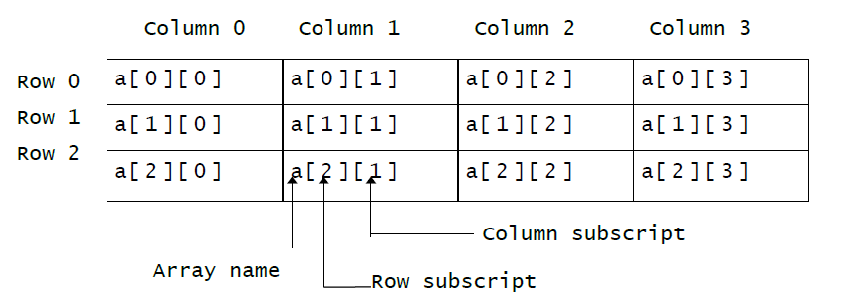

Slide 10
Array Initialization (2-D):
The general format of array initialization is:
data_type array_name[row_size][col_size]= {element1,element2,…………..,element n};
for example:
int a[2][3]={33,44,23,56,77,87};
or
int a[2][3]={{33,44,23},
{56, 77, 87}};

Slide 11
Structure:
A structure is a collection of one or more variables, possibly of different types grouped together under a single name.
An array is a data structure in which all the members are of the same data type.
Structure is another data structure in which the individual elements can differ in type. Thus, a single structure might contain integer elements, floating-point elements and character elements.
The individual structure elements are referred to as members.
Defining a structure:
struct structure_name
{
member 1;
member 2;
………..
member n;
};

Slide 12
We can define a structure to hold the information of a student as follows:
struct Student
{
char name[12];
int roll;
char sec;
float marks;
};

Slide 13
Structure variable declaration:
struct Student s1, s2, s3;

Slide 14
THANK YOU

